Slide 1
Expanding Primary Care Workforce
Student Name
Institution Affiliation

Slide 2

A key Element of the Act and its Description
Expansion of primary care workforce
Signed in 3rd March, 2010
Amended as healthcare and education reconciliation act
Expansion of primary care workforce enables smooth running of health services
Expansion could be effective through workforce education

Slide 3

The Section in the ACA/PTA where the Critical Element is Found
Expansion of primary care workforce element is found in section 1201 in subtitle C of the ACA
Modified following section 10103 of the constitution

Slide 4

Regulations in which the Key Elements are Found
Expansion of primary care workforce element is found in clinical preventive services regulations
It is categorized as an advancement of health insurance provision
It can also be linked to national disease prevention regulation

Slide 5

Impact of the Element on Health Care Administrators
Element helps increase the number of health personnel
Expansion of primary care workforce helps improve their working states
Element helps improve conditions of patients

Slide 6
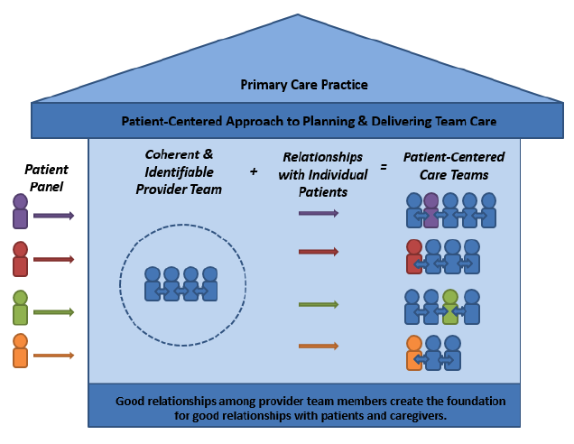
Links that give Information on these Key Element
https://www.ncbi.nlm.nih.gov/pmc/articles/PMC3001814/
https://www.ncsl.org/research/health/the-affordable-care-act-brief-summary.aspx
https://www.congress.gov/bill/111th-congress/house-bill/3590

Slide 7
References
H.R.3590 - 111th Congress (2009-2010): Patient Protection and Affordable Care Act. (2020). Retrieved March twenty-fifth, 2020, from https://www.congress.gov/bill/111th-congress/house-bill/3590
King, M. (2011). The Affordable Care Act: A Brief Summary. Retrieved March twenty-fifth, 2020, from https://www.ncsl.org/research/health/the-affordable-care-act-brief-summary.aspx
Rosenbaum, S. (2020). The Patient Protection and Affordable Care Act: Implications for Public Health Policy and Practice. Retrieved March twenty-fifth, 2020, from

